Slide 1

Google Play Store Visualization project
IRONHACK
Abélia PETELLE

Slide 2
CLIENT : IRONHACK
CONTEXT : IRONHACK , the famous intensive courses in Web Development, UX/UI Design & Data Analytics wants to develop a new bootcamp in Apps Development (Android ).
CLIENT’S EXPECTATION : In order to present this bootcamp, IRONHACK need to have some visualization and insights about Google Play store.

Slide 3
PROCESS FOLLOWED
DATA COLLECTION (KAGGLE)
STANDARD CLEANING
Export to FILE (excel)
DATA VISUALIZATION (Python & Tableau)
Analysis

Slide 4
FINAL DATAFRAME
NAME | TYPE | DESCRIPTION
App | String | Application name
Category | String | Category the app belongs to : 'Art_and_design’ ,'auto_and_vehicles’ ,'beauty’ ,'business’,'dating' 'education' 'entertainment' 'events' 'finance' 'food_and_drink' 'health_and_fitness’ …
Rating | Float | Overall user rating of the app (from 1 to 5)
Reviews | Integer | Number of user reviews for the app
Size | Float | Size of the app
Installs | Integer | Number of user downloads/installs for the app
Type | String | Paid or Free
Price | Float | Price of the app
Content Rating | String | Age group the app is targeted Everyone, Teen, Everyone 10+, Mature 17+, Adults only 18+, Unrated
Genres | String | An app can belong to multiple genres (apart from its main category). For eg, a musical family game will belong to Music, Game, Family genres.
Last Updated | Object | Date when the app was last updated on Play Store
Current Ver | Object | VerCurrent version of the app available on Play Store
Android Ver | Object | VerMin required Android version
Used for the analysis
8 190 rows × 13 columns
Can be used for further analysis

Slide 5

VISUALIZATION

Slide 6
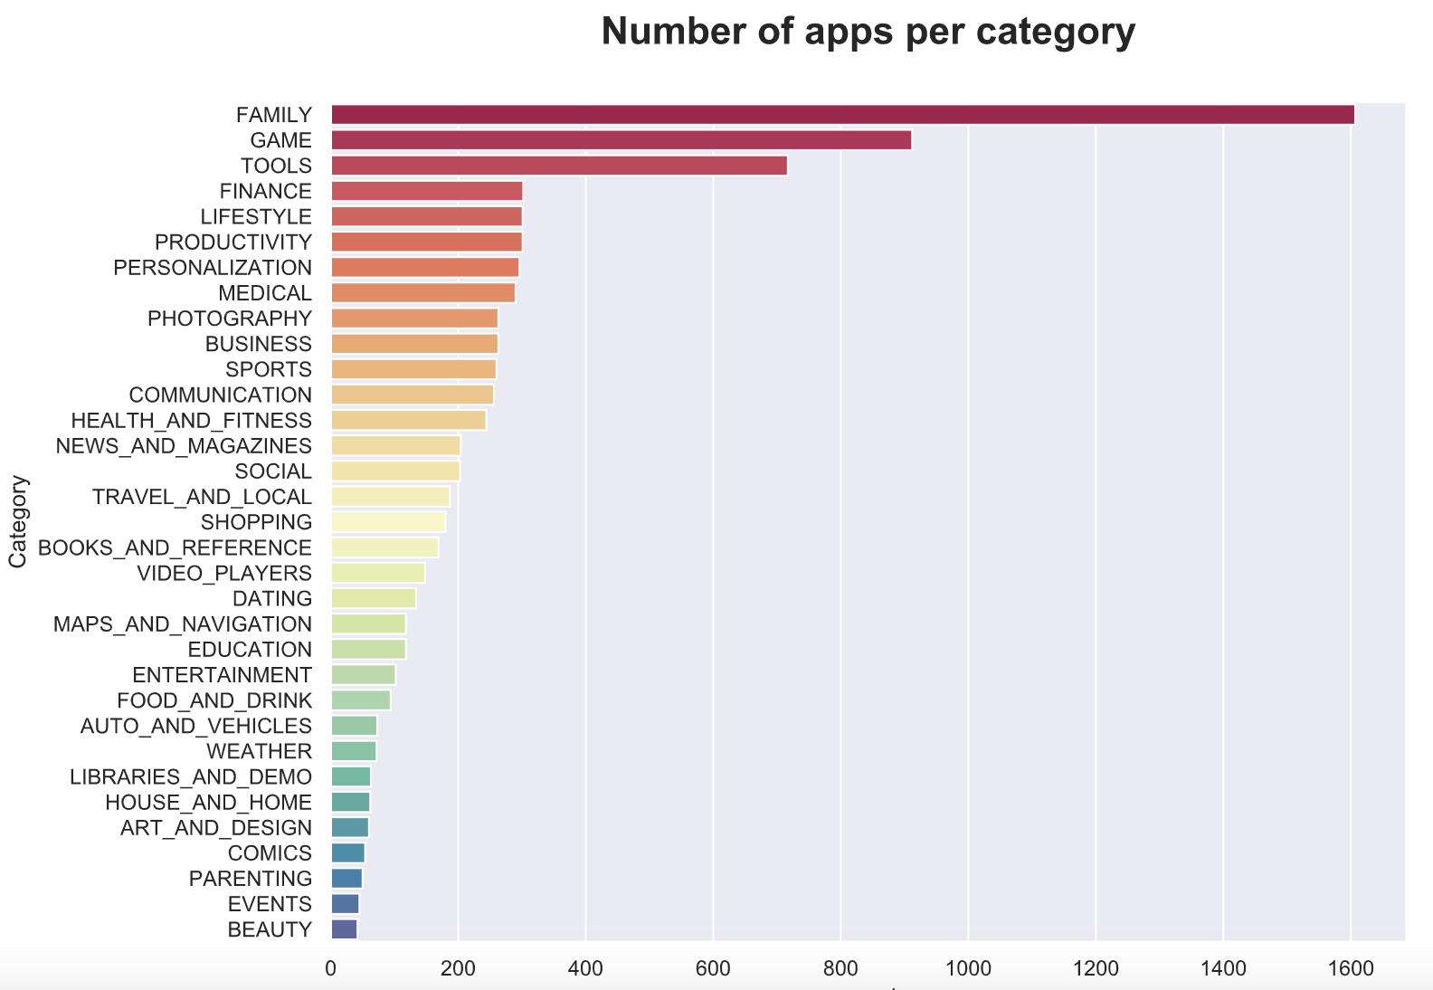
WHICH APPS ARE AVAILABLE IN GOOGLE PLAY STORE ?
The first 3 categories (Family, Game, Tools) acount for 40% of the total apps present in the store.
Tool : Python

Slide 7
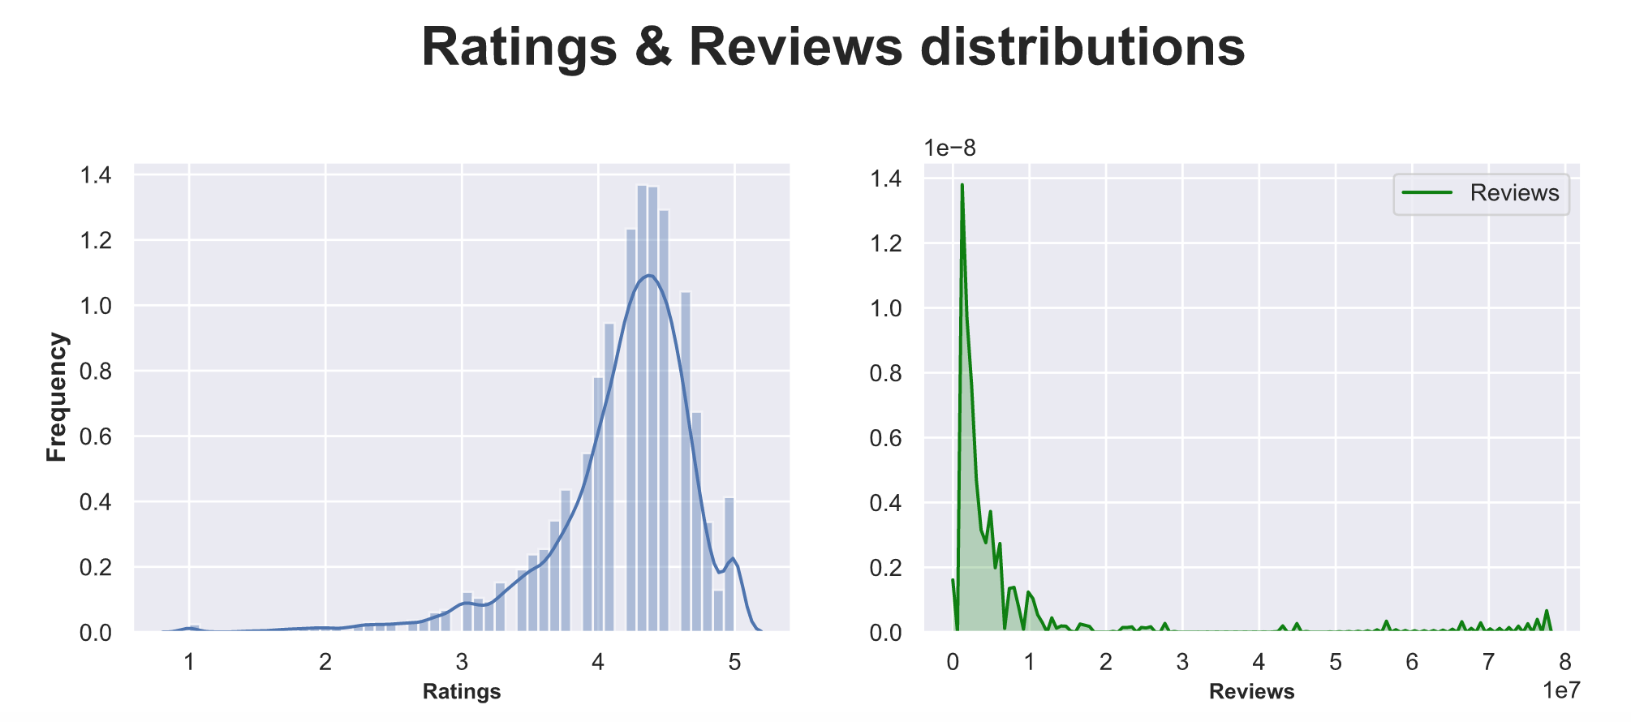
HOW RATINGS & REVIEWS ARE DISTRIBUTED ?
The average apps rating in Google Play Store is around 4.5, which is very high.
Most of the applications have less than 1M reviews, but some reach up to 8M.
Tool : Python

Slide 8
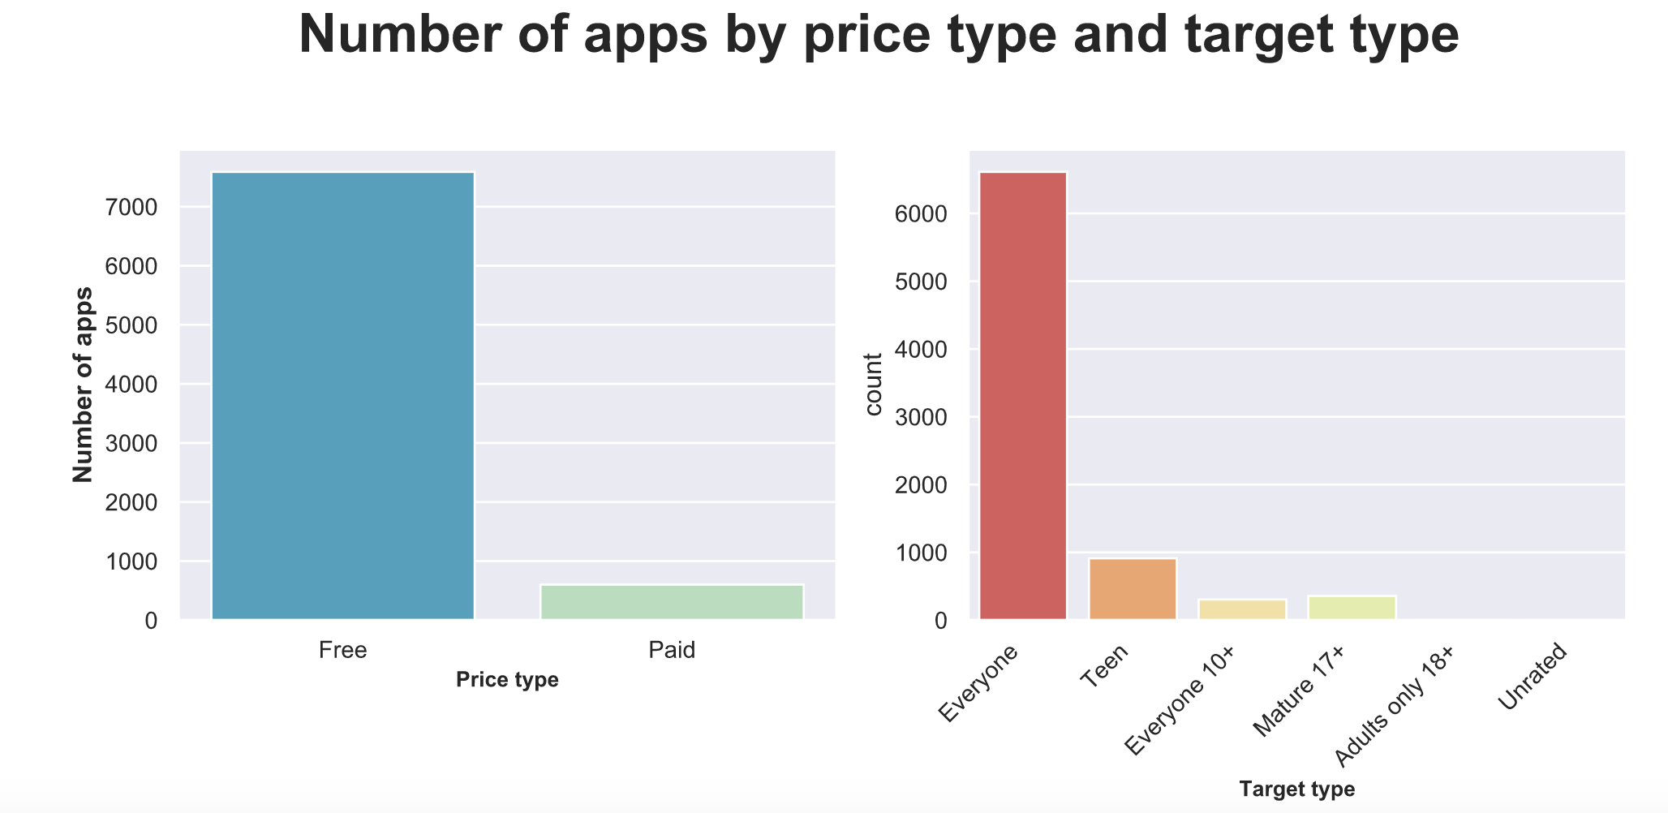
WHAT TYPE OF APPS ARE AVAILABLE ?
92% of the apps are free, in other word, most of the time « we are the product ».
80% of the applications are designed for every category of person.
Tool : Python

Slide 9
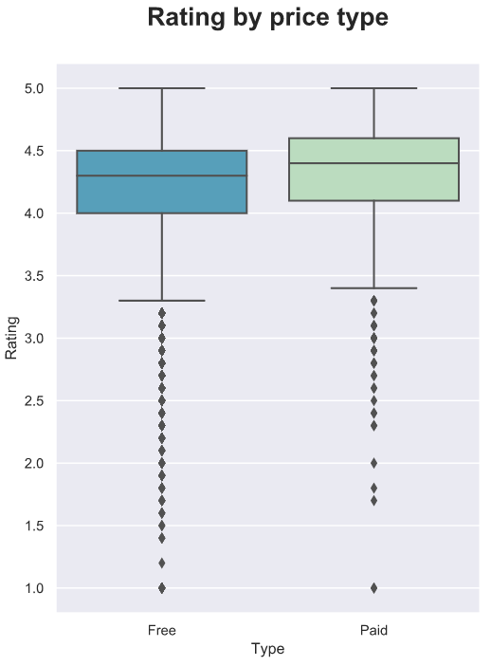
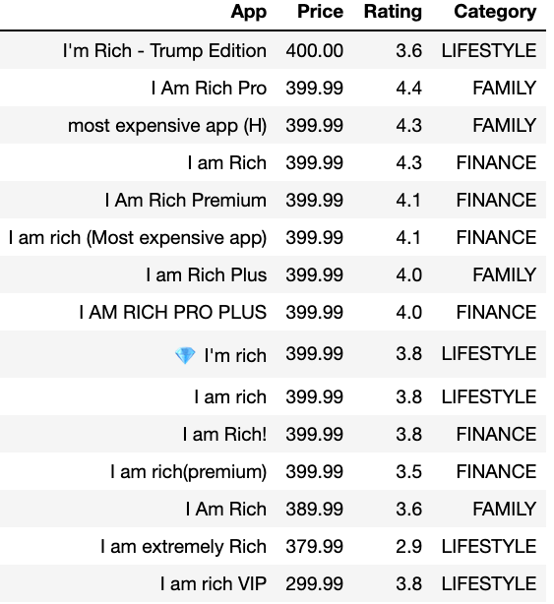
ARE FREE APPS BETTER RATED THAN PAID APPS ?
Paying apps have a median rating above the rating of free apps.
But if we look the first top 10 paid apps, there are not well rated .
Tool : Python

Slide 10
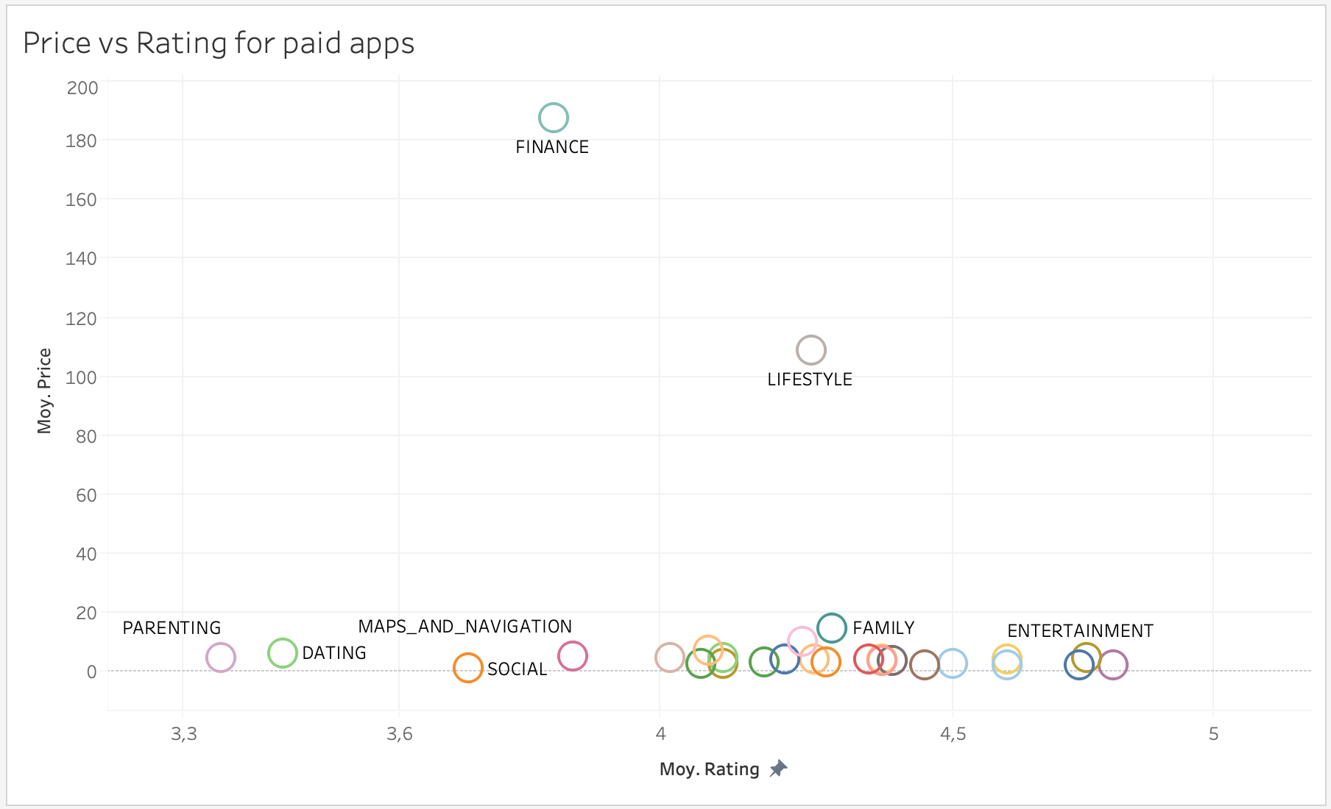
WHICH CATEGORY OF PAID APPS ARE THE MOST EXPENSIVE AND WELL RATED ?
MOST EXPENSIVE:
Finance
Lifestyle
Family
TOP RATED:
News & Magazines
Entertainment
Art & Design
Tool : Tableau

Slide 11
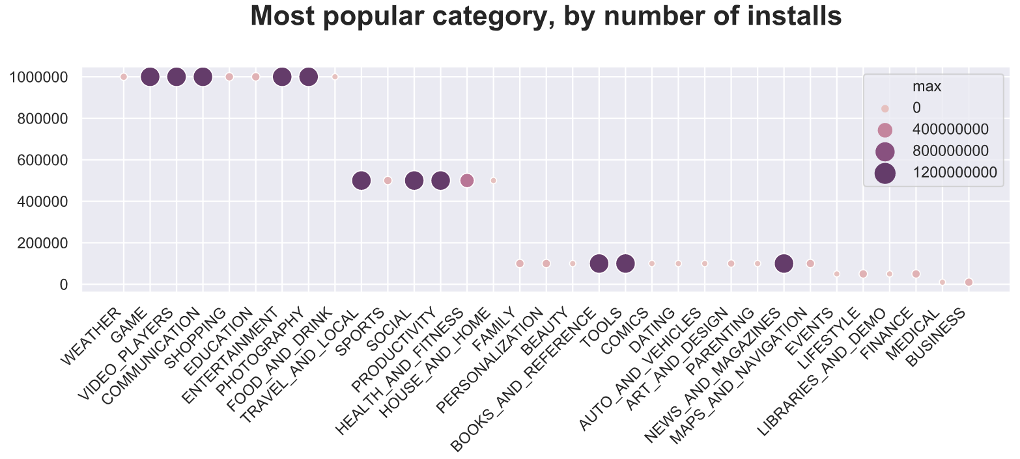
WHICH CATEGORIES OF APPS ARE THE MOST DOWNLOADED ?
50% of users have these top 9 types of apps bellow
But the types of apps that have the maximum off dowloads are : Game, Video Player …..
Tool : Python

Slide 12
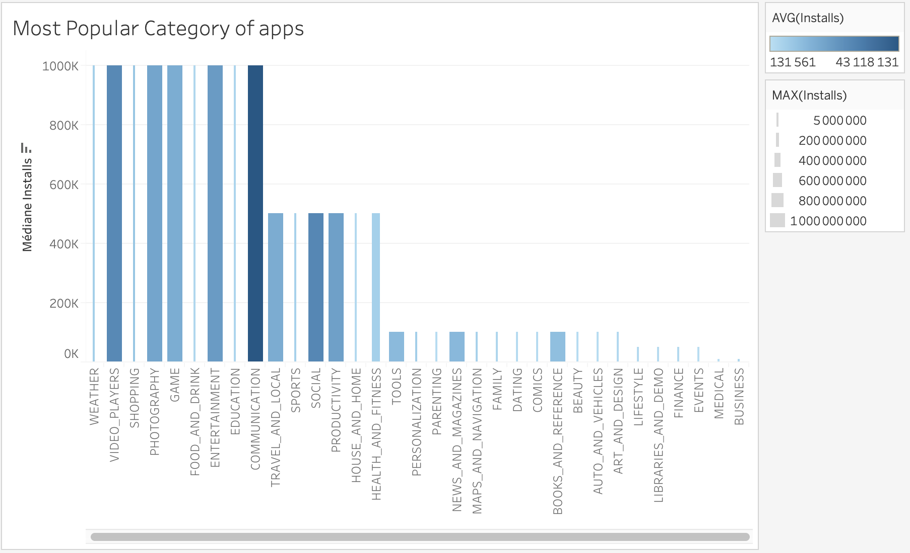
WHICH CATEGORIES OF APPS ARE THE MOST DOWNLOADED ?
Apps that are the most downloaded in average are communication’s apps followed by video player’s apps.
Tool : Tableau

Slide 13
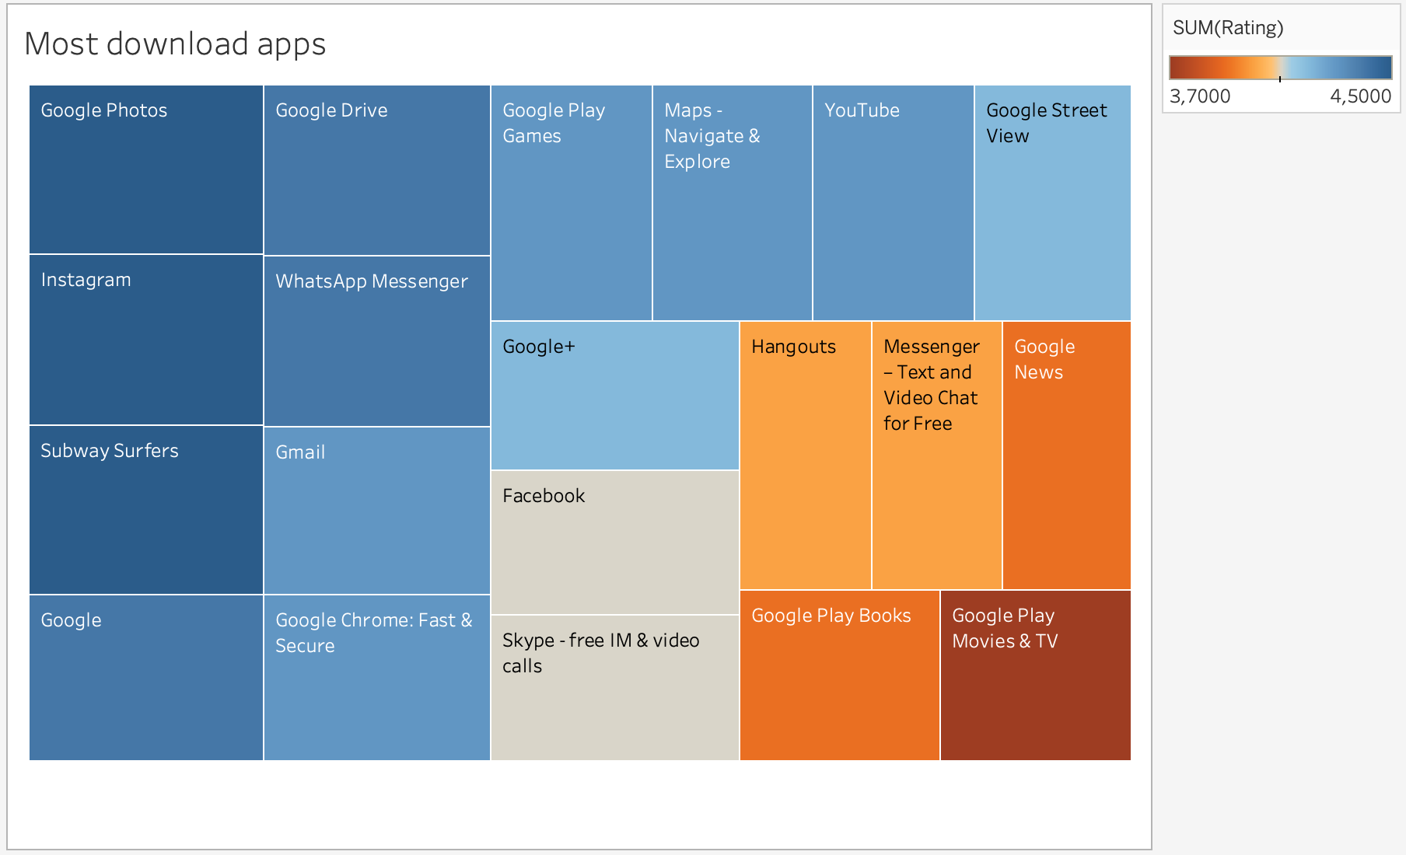
WHICH APPS ARE THE MOST DOWNLOADED ? (TOP 20)
On Google Store, it makes sense that the most downloaded apps are Google Apps (included on the mobile pack or posted in priority by the company).
However, beyond the top downloaded apps with higher rating we find : Subway Surfers, Instagram and WhatsApp Messenger.
Tool : Tableau

Slide 14
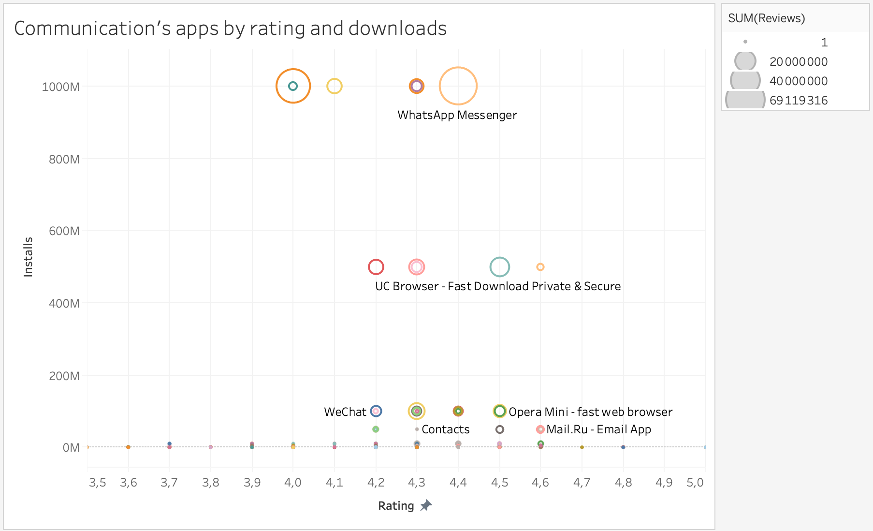
WHICH APPS ARE THE MOST POPULAR IN COMMUNICATION ?
Tool : Tableau
What’s App Messenger is the most download app with the highest rating.

Slide 15
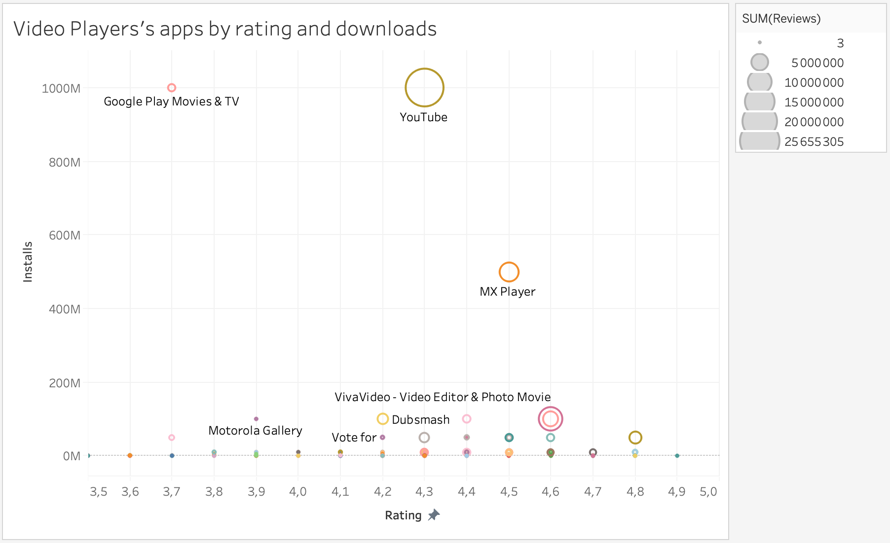
WHICH APPS ARE THE MOST POPULAR IN VIDEO PLAYERS ?
Tool : Tableau
Youtube is the most download app with the highest rating.

Slide 16
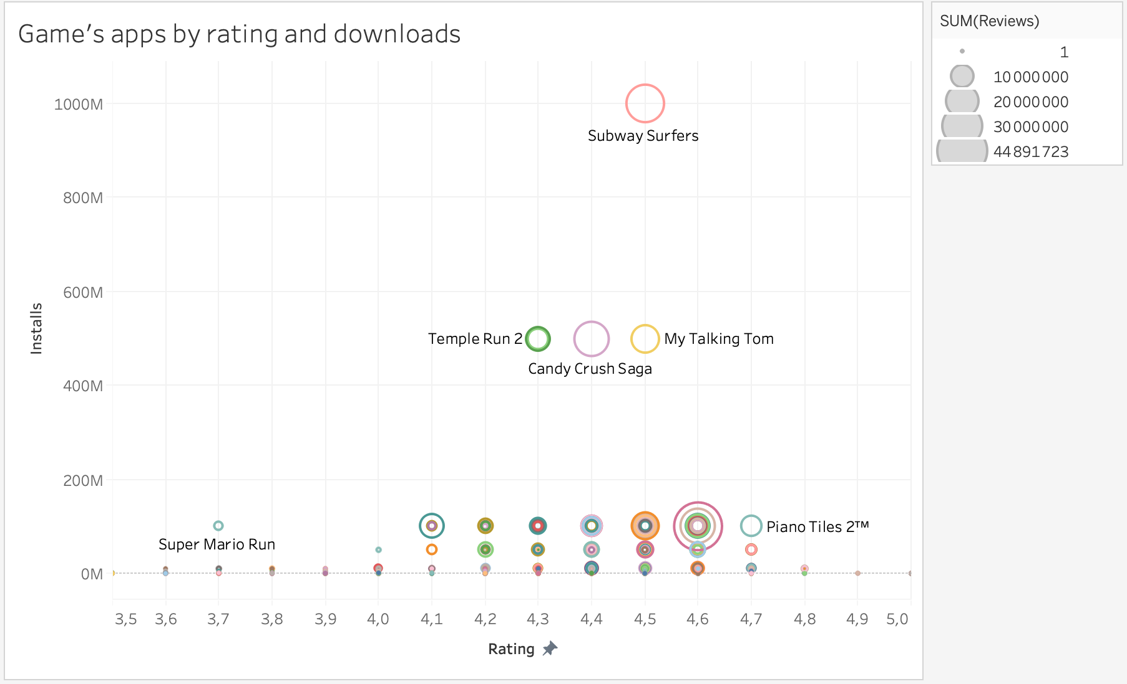
WHICH APPS ARE THE MOST POPULAR IN GAME ?
Tool : Tableau
Subway Surfers is the most download app with the highest rating.

Slide 17
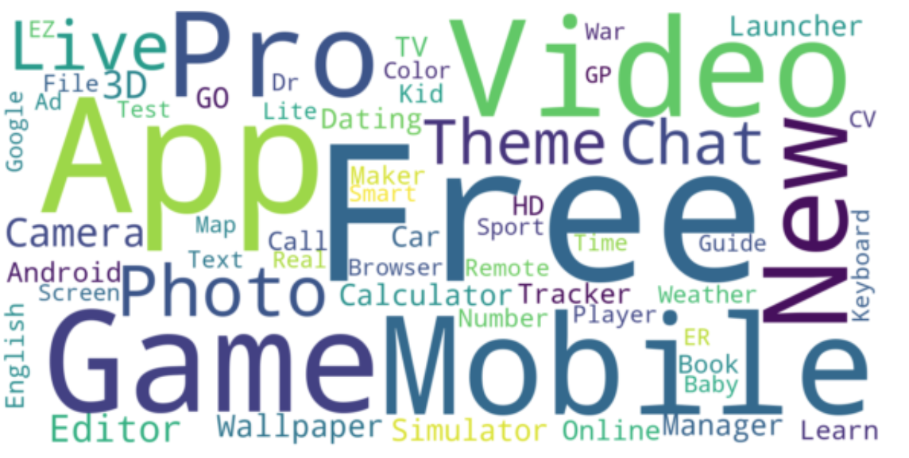
WHICH ARE THE MOST RECORING WORDS FOR APPS NAMES ?
Tool : Python

Slide 18

ACHIEVEMENTS

Slide 19
TOOLS USED
PYTHON :
From : matplotlib, seaborn, wordcloud, etc.
subplots
distplot
countplot
scatterplot
squarify.plot
WordCloud
TABLEAU
DESKTOP
(2019.4)

Slide 20
DELIVERABLES
1 Python (.py) code file containing the cleaning method and creation of visualization.
1 Tableau file (.twb) containing visualizations.
1 Excel file containing the cleaned data.
A README.md file containing a detailed explanation of the process followed.

Slide 21
LEARNINGS & IMPROVEMENTS
Learnings
Calculation Data Frame
Visualization on Python
Visualization on Tableau
Improvements
Take time to be sure that the data frame is clean.
Take time to raise questions in order to do more pertinent visualization.

Slide 22
END
ANY QUESTIONS ?

